Slide 1
Building an Active Directory Lab with VirtualBox

Slide 2
In this Video, we are going to take a look at…
Discovering where to get the programs and ISO files required
Notes:
This slide, like mentioned above is for multiple pointers. The information above covers the types of information that can be used in this slide

Slide 3
In this Video, we are going to take a look at…
Discovering where to get the programs and ISO files required
Basic setup and walkthrough of VirtualBox
Notes:
This slide, like mentioned above is for multiple pointers. The information above covers the types of information that can be used in this slide

Slide 4
In this Video, we are going to take a look at…
Discovering where to get the programs and ISO files required
Basic setup and walkthrough of VirtualBox
Building the virtual machines and power them on
Notes:
This slide, like mentioned above is for multiple pointers. The information above covers the types of information that can be used in this slide

Slide 5
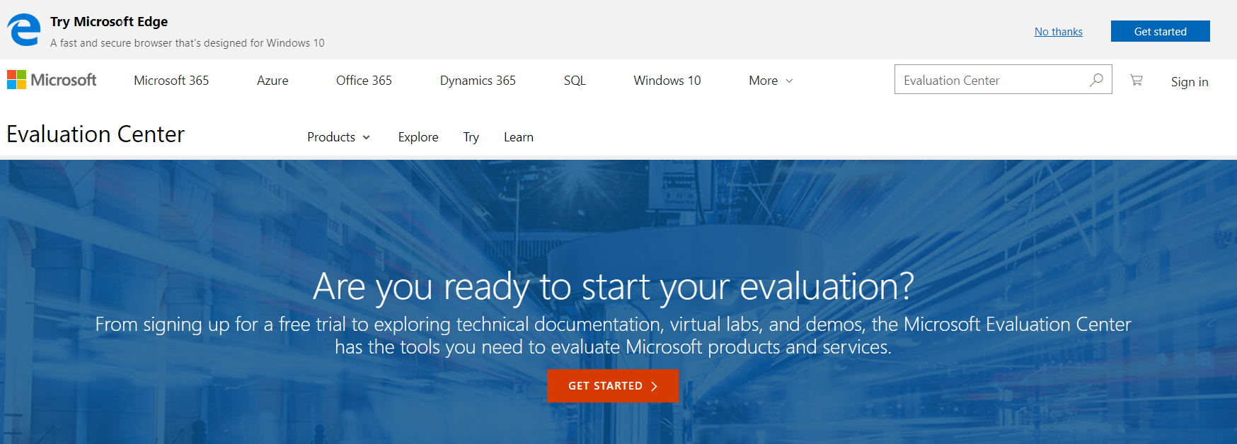
https://www.Microsoft.com/en-us/evalcenter/

Slide 6
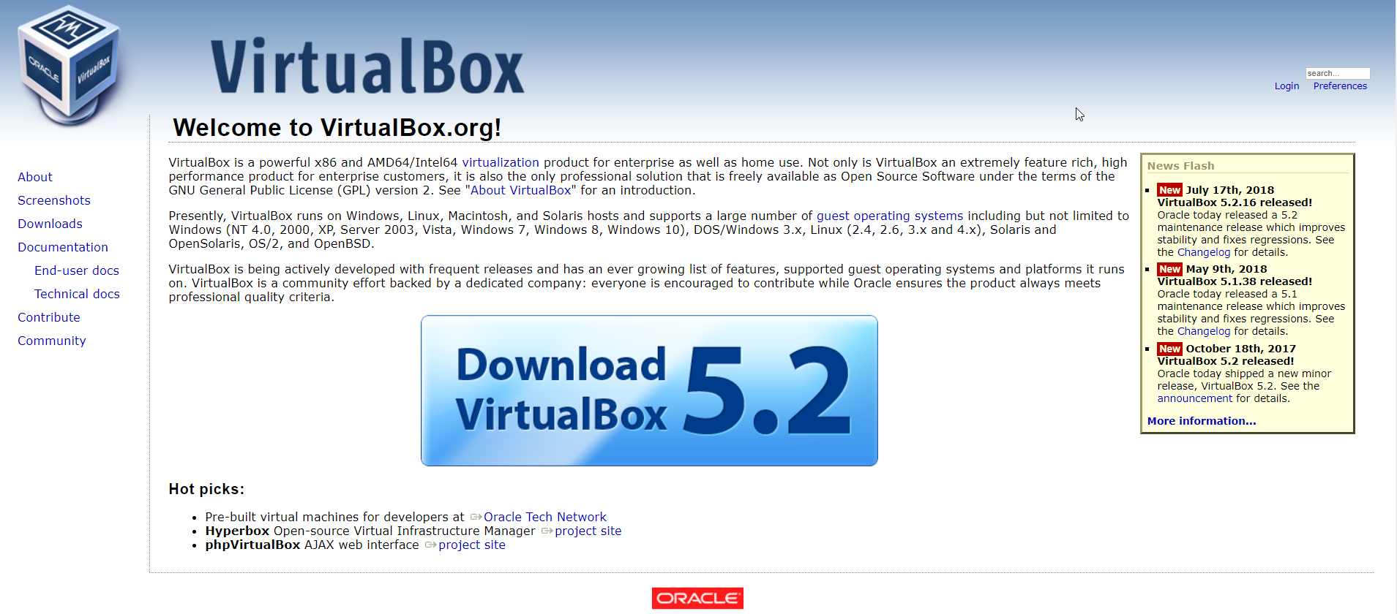
https://www.Microsoft.com/en-us/evalcenter/

Slide 7
Building an Active Directory Lab with Hyper-V
Next Video

